Slide 1
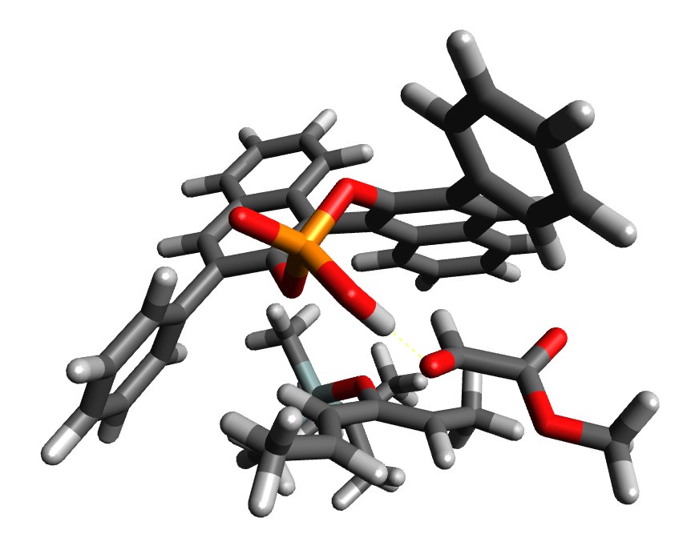
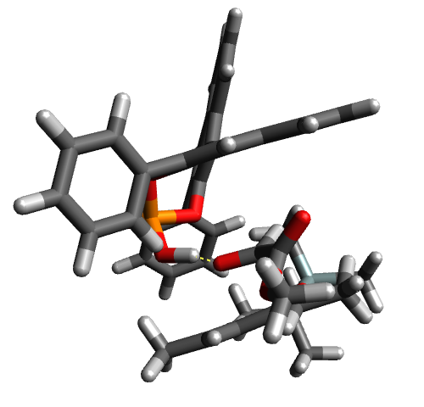
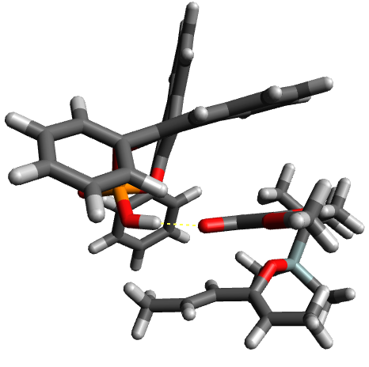
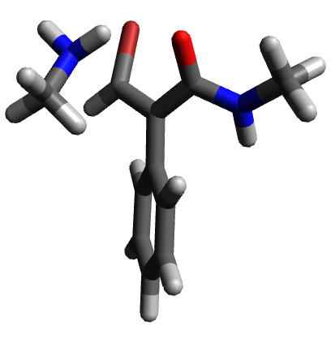
TS searching with mixed method Hessians
January 2024

Slide 2
Pre-optimising at a lower level of theory
SQM (PM6 PCM(toluene)):
4x optimisation cycles, 153 steps, 11h-17m-47.3s
HF (HF 6-31G* PCM(toluene))
8x optimisation cycles, 374 steps, 15d-14h-22m-54.5s
LDA (SVWN def2-SVP PCM(toluene))
10+ optimisation cycles, 500+ steps, 16d+
BPA_TS_1
(catalysed hetero Diels-Alder)
SQM (PM6 PCM(toluene)):
1x optimisation cycle, 36 steps, 19m-55.3s
HF (HF 6-31G* PCM(toluene))
1x optimisation cycle, 23 steps, 1h-15m-11.6s
LDA (SVWN def2-SVP PCM(toluene))
3x optimisation cycles, 131 steps, 9h-38m-31.7s
TS_68
(uncatalysed aza-Michael)

Slide 3
Re-optimising lower-level structures to DFT (wB97XD def2-SVP PCM(toluene))
SQM → DFT :
?x optimisation cycle, ? steps, ?
HF → DFT :
?x optimisation cycle, ? steps, ?
LDA → DFT :
?x optimisation cycles, ? steps, ?
DFT:
6x optimisation cycles, 73 steps, 17d-8h-17m-43s
BPA_TS_1
(catalysed hetero Diels-Alder)
SQM → DFT :
4x optimisation cycles, 161 steps, 22h-43m-54.8s
HF → DFT :
1x optimisation cycle, 16 steps, 1h-59m-55.9s
LDA → DFT :
4x optimisation cycles, 181 steps, 21h-59m-30.1s
DFT:
1x optimisation cycle, 27 steps, 4h-11m-38.1s
TS_68
(uncatalysed aza-Michael)

Slide 4
External keyword for Gaussian interface
External keyword:
Run TS optimisation all in one Gaussian input file using:
external=“~/scripts/MiMe -F ‘pm6’ -EF ‘wb97xd def2svp’ -c 12 -m 48GB” opt=(recalcfc=N,ts,noeigen,…,nomicro)
2. No need for additional frequency calculations, but does require a working script to interface with G16 via External
3. G16 sends the python script (MiMe) a Gau-12345.EIn “input” file containing [a] deriv = d where d is the derivatives of Energy, and [b] the molecule specification (charge, spin and geometry in standard orientation in Bohrs)
4. Python script reads in Gau-12345.EIn and sends off a new G16 calculation of Energy, Force, or Freq (if d = 0,1,2) and returns those values to the main G16 task via the Gau-12345.EOu “output” file
Previously:
1. Run separate Freq=noraman calculation at lower level of theory (e.g. PM6, HF 6-31G*, SVWN def2-SVP) with %chk=freq.chk keyword
2. Move checkpoint file from frequency calculation to folder with optimisation Gaussian input file
3. Use %chk=freq.chk with opt=(readfc,ts,noeigen, maxcyles=N,…) keyword arguments for optimisation
4. This is designed to load in the low-level hessian into a higher-level TS optimisation, with new hessians recalculated every N steps

Slide 5
External keyword for Gaussian interface
deriv >= 1
Gaussian GJF
FORCE:
wb97xd def2svp
E,D,F
Gaussian GJF
OPT
external=MiMe
.Ein
deriv=N
Geom
MiMe
.Eou
E, D,
F,
H
deriv = 2
Gaussian GJF
FREQ:
pm6
H

Slide 6
External keyword for Gaussian interface
Currently MiMe does not replicate the results obtained by using an external frequency calculation, reading in the Hessians via the opt=readfc keyword argument. The calculations begin very similarly, with the identical Forces and similar Eigenvalues but these numbers diverge the longer the calculation goes on for – leading to slightly more steps being taken with External and therefore taking longer:
Currently testing on DA-1_2 (acrolein Diels-Alder dimerization) at 23 steps vs 21 steps and on TS_68 (uncatalysed aza-Michael reaction) at 42 steps vs 42 steps for calcfc
One possibility is that each Freq calculation involves a putative Berny optimisation step, and the Hessian after optimisation is what is used by readfc whereas the Hessian before optimisation is used by External (or vice versa). i.e. the Hessians are incorrect from the start (or from the 2nd step onwards)
Another explanation is that the Hessians begin the same but are updated in different ways by the Berny / LBFGS update scheme over the course of optimisation.
It would be worth getting the External keyword to work, since this would allow us to intercept the low-level Hessian and improve it with ML before passing it back to G16, and because the process is more self-contained (no explicit Freq calculations).
The problem is likely to involve the use of the Hessian and Forces in converting between Cartesian coordinates and Internal Coordinates – when mixed Hessians and Forces are used the change of coordinates introduces an error

Slide 7
External keyword for Gaussian interface
Once the external keyword is able to replicate the optimisation results for readfc:
Investigate different frequencies of Hessian calculation using opt=(calcfc,recalcfc=N,…) for N = {1=calcall, 2, 5, 10, 20, 50=calcfc}
2. Create a script to intercept the Geometry and Hessians from MiMe and use delta-ML to improve the low-level Hessian towards the higher-level (DFT) Hessian
3. Test ML Hessians with different combinations of low and high level of theory (or select one high level of theory and try different low levels e.g. SMQ-wB97xd, HF-wB97xd, LDA-wB97xd

Slide 8
TS structures: OPLS3e initial geometries (reacting bonds constrained)
Phosphoric-acid catalysed Hetero Diels-Alder
(two different conformers)
BPA_1, BPA_2
Aza-Michael reactions
AM_249, AM_898, AM_325, AM_68
Diels-Alder reactions
IMDA_1, IMDA_2,
DA_1, DA_2
1,3-Dipolar
cycloadditions
allylic, cyclic
1
1
2
2

Slide 9
Hessian levels of theory: SQM, HF, DFT
DFT (wB97xd/def2-SVP)
HF (HF/6-3G(d))
SQM (PM6)
%chk=BPA_TS_1_opt_hf.chk
%nprocshared=12 %mem=48GB
# wb97xd def2svp geom=allchk scrf=(iefpcm,solvent=toluene) opt=(readfc,ts,noeigen,maxcycles=50,maxstep=10)
(BPA_TS_1_hf.chk obtained from previous opt)
%chk=BPA_TS_1_opt_sqm.chk
%nprocshared=12 %mem=48GB
# wb97xd def2svp geom=allchk scrf=(iefpcm,solvent=toluene) opt=(readfc,ts,noeigen,maxcycles=50,maxstep=10)
(BPA_TS_1_opt_sqm.chk obtained from previous opt)
%chk=BPA_TS_1_opt_dft.chk
%nprocshared=12 %mem=48GB
# wb97xd def2svp geom=allchk scrf=(iefpcm,solvent=toluene) opt=(readfc,ts,noeigen,maxcycles=50,maxstep=10)
ReadFC
%chk=BPA_TS_1_opt_hf.chk
%nprocshared=12 %mem=48GB
# wb97xd def2svp geom=allchk
scrf=(iefpcm,solvent=toluene) opt=(readfc,ts,noeigen,maxcycles=50,maxstep=10)
(BPA_TS_1_hf.chk obtained from
a new hf 6-31g(d) hessian calculation)
%chk=BPA_TS_1_opt_sqm.chk
%nprocshared=12 %mem=48GB
# wb97xd def2svp geom=allchk scrf=(iefpcm,solvent=toluene) opt=(readfc,ts,noeigen,maxcycles=50,maxstep=10)
(BPA_TS_1_opt_sqm.chk obtained from
a new pm6 hessian calculation)
%chk=BPA_TS_1_opt_dft_re.chk
%nprocshared=12 %mem=48GB
# wb97xd def2svp geom=allchk
scrf=(iefpcm,solvent=toluene) opt=(calcfc,ts,noeigen,maxcycles=50,maxstep=10)
CalcFC

Slide 10
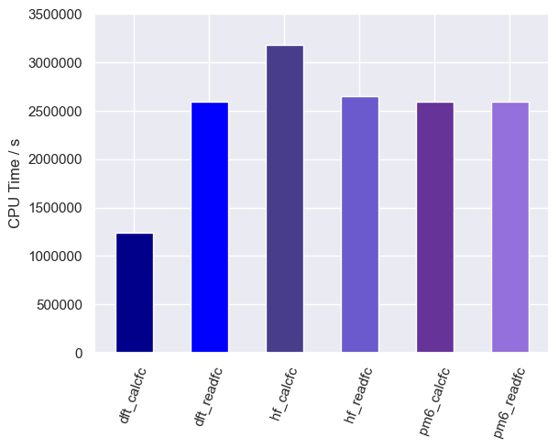
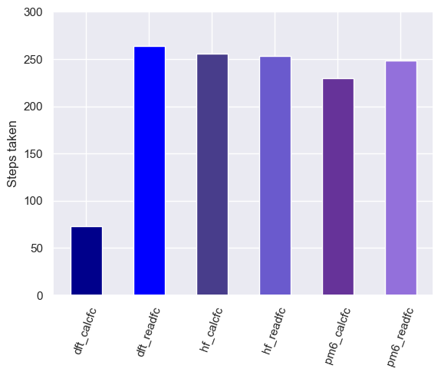
BPA_1
*
*
*
*
*
*
*
*
*
*
* TS structure did not optimise after 10 job cycles

Slide 11
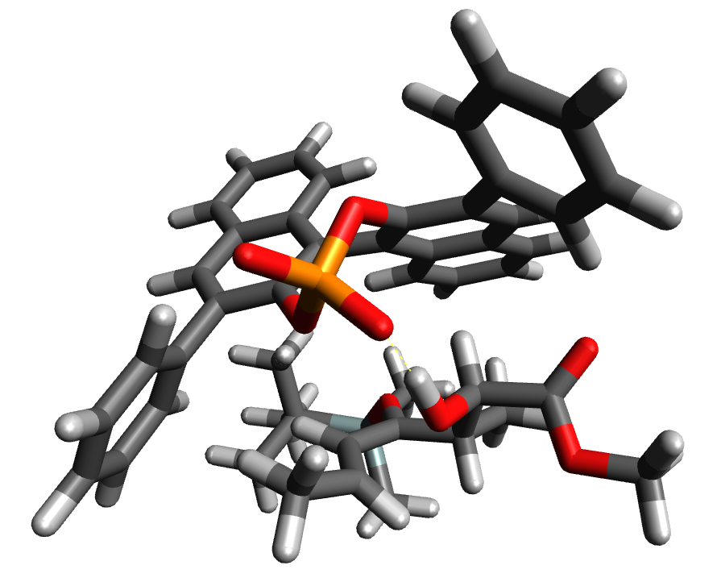
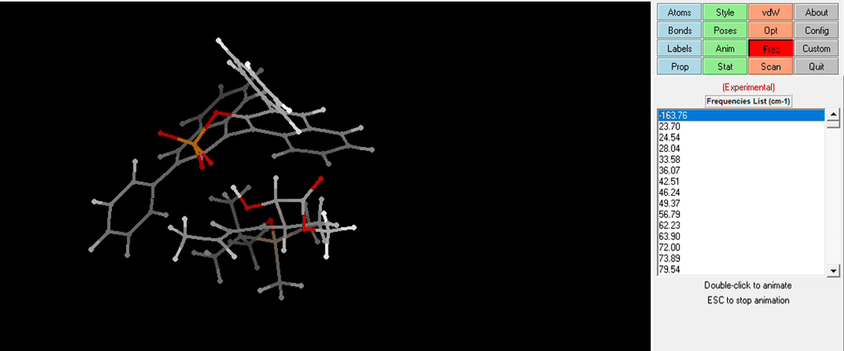
BPA_1: conformation
DFT calcfc
(no other jobs converged)

Slide 12
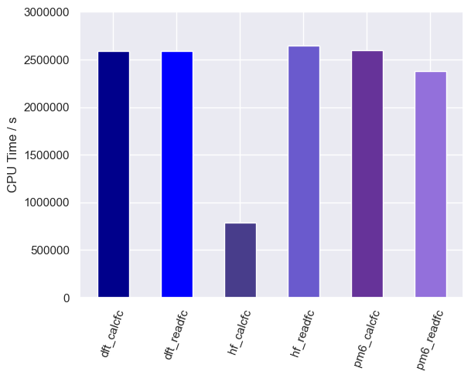
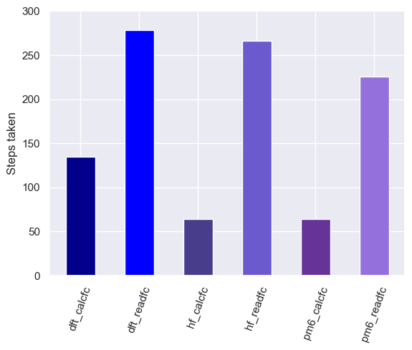
BPA_2
*
*
*
*
*
*
*
*
*
*

Slide 13
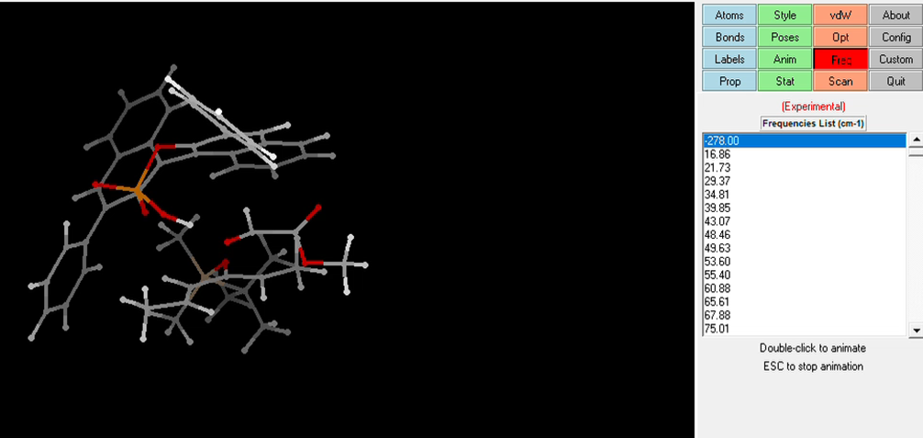
BPA_2: conformation
HF calcfc
(no other jobs converged)

Slide 14
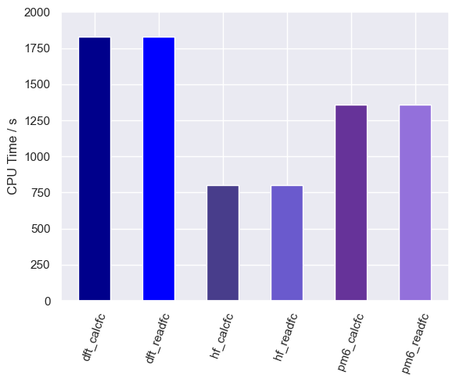
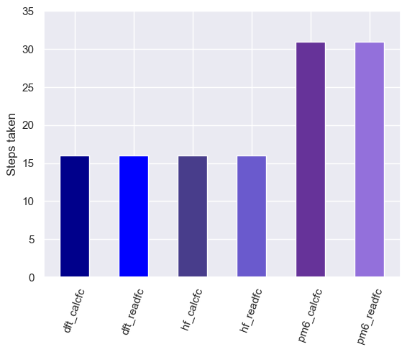
AM_249

Slide 15
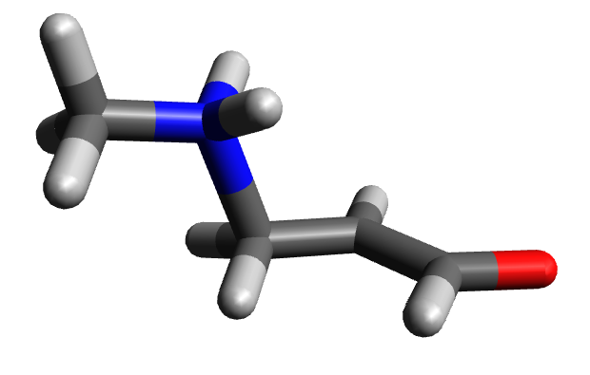
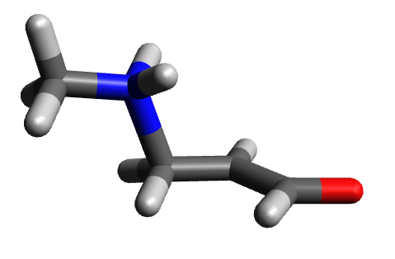
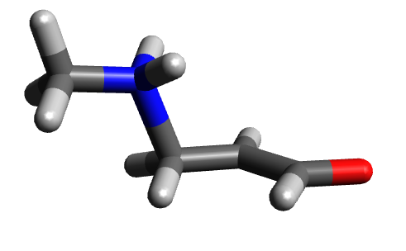
AM_249: conformations
DFT Hessian
HF Hessian
SQM Hessian

Slide 16
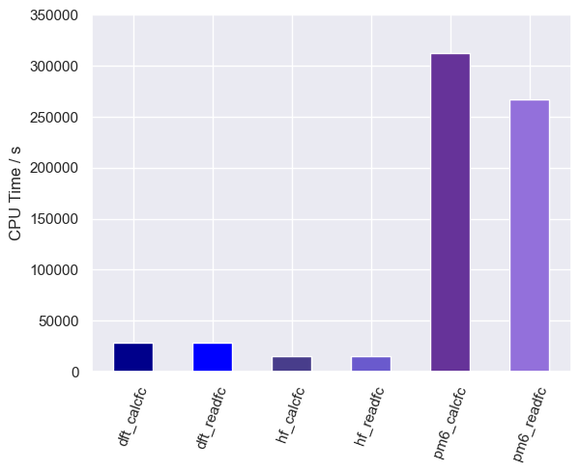
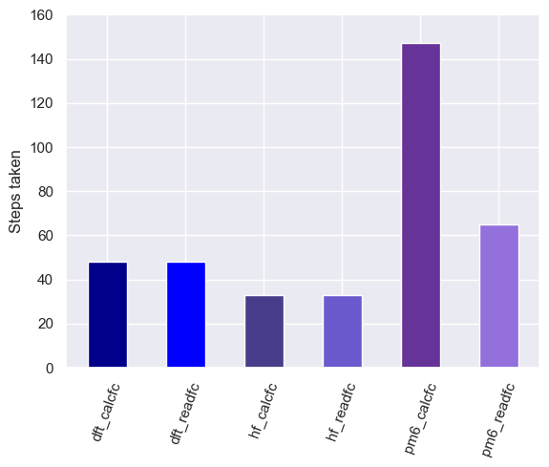
AM_325

Slide 17
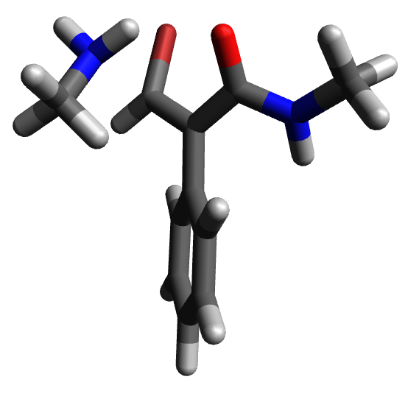
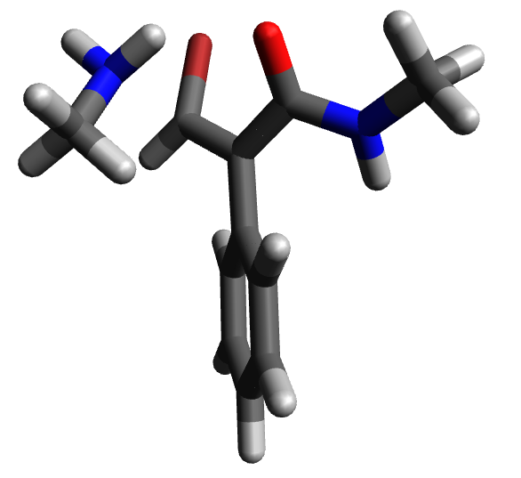
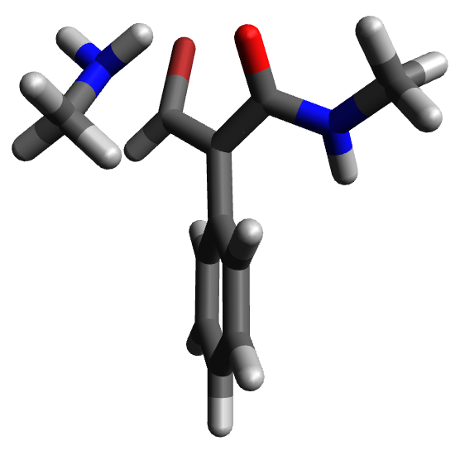
AM_325: conformations
DFT Hessian
HF Hessian
SQM_calcfc
SQM_readfc

Slide 18
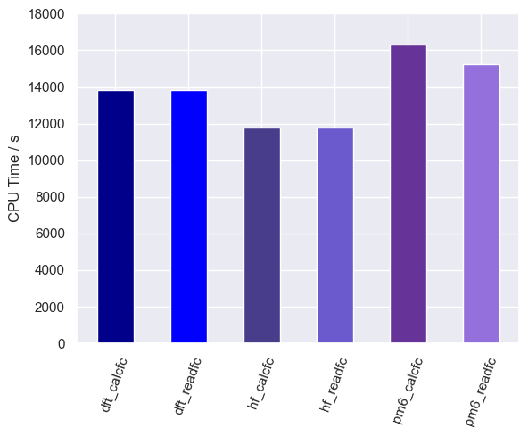
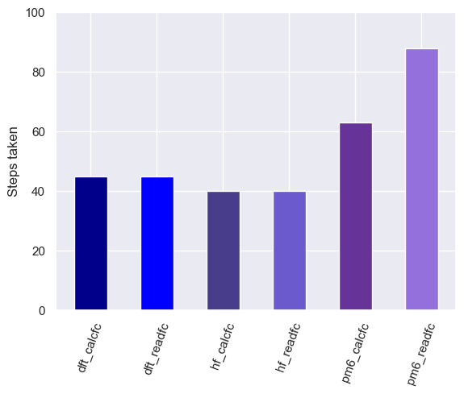
AM_898

Slide 19
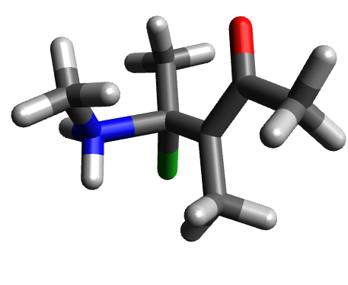
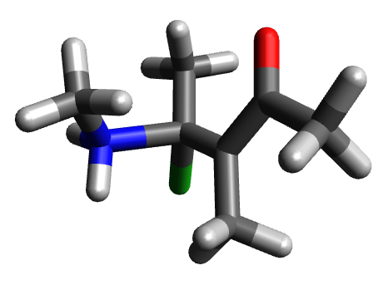
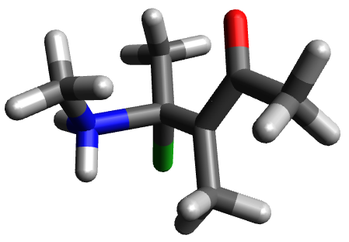
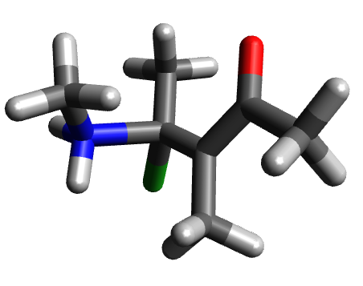
AM_898: conformations
DFT Hessian
HF Hessian
SQM_calcfc
SQM_readfc

Slide 20
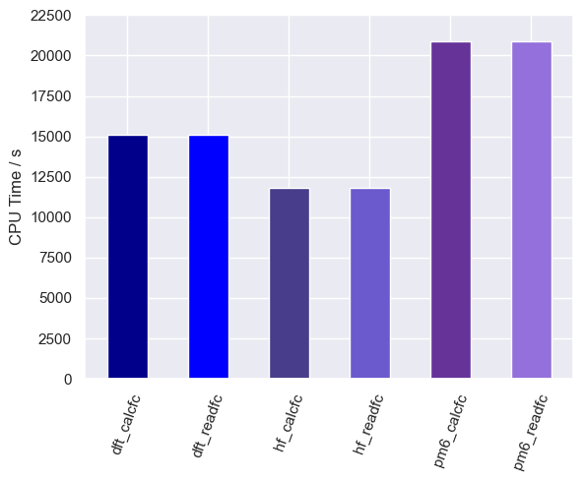
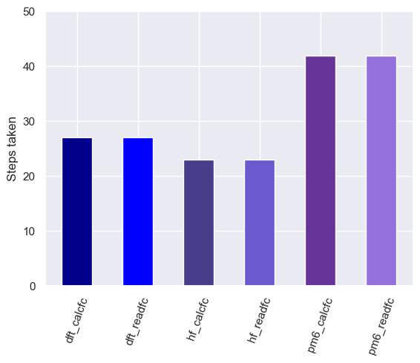
AM_68

Slide 21
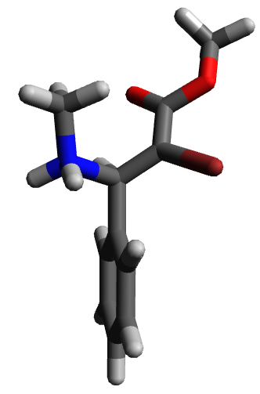
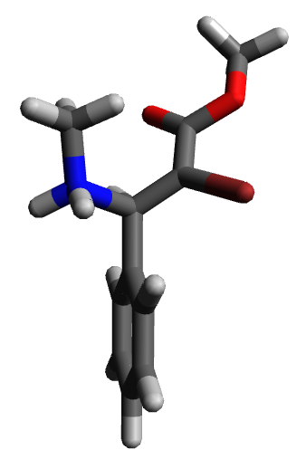
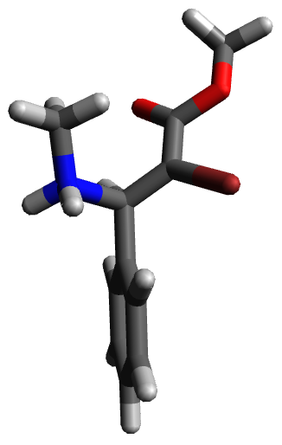
AM_68: conformations
DFT Hessian
HF Hessian
SQM Hessian

Slide 22
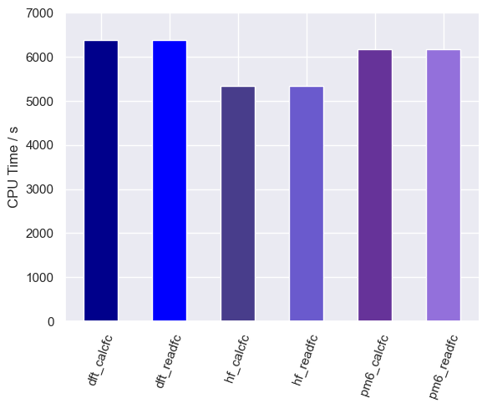
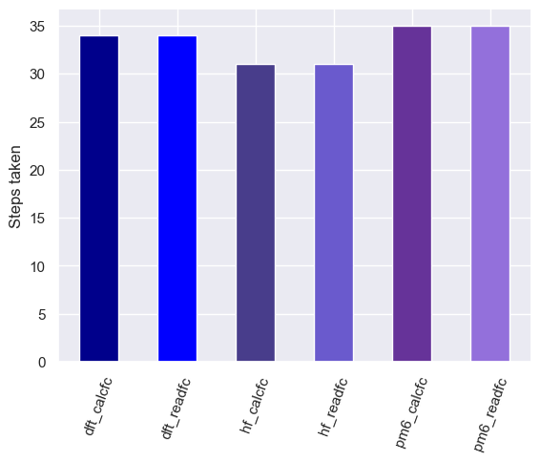
allylic

Slide 23
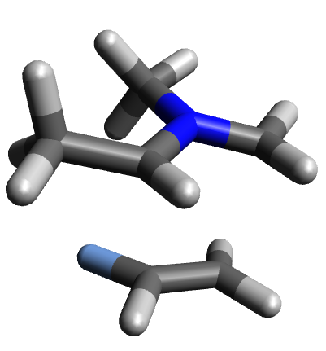
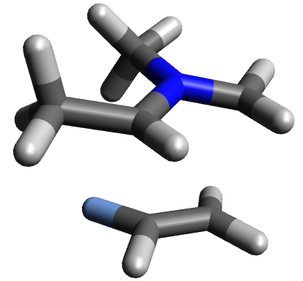
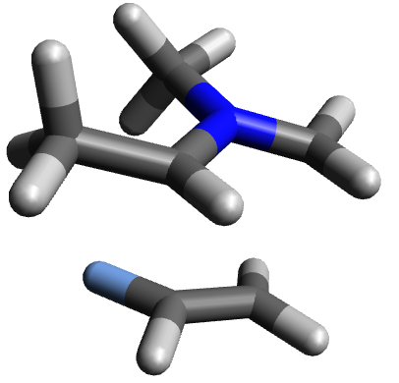
allylic: conformations
DFT Hessian
HF Hessian
SQM Hessian

Slide 24
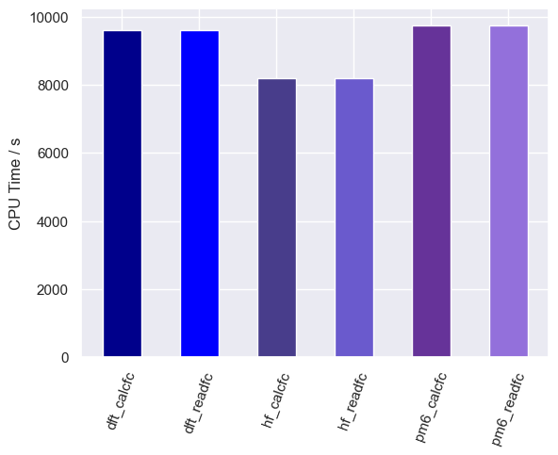
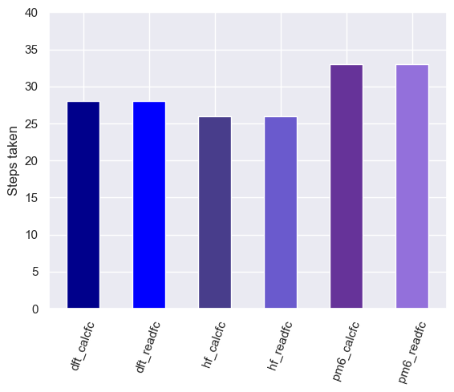
cyclic

Slide 25
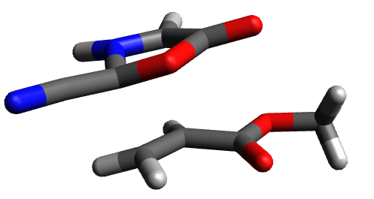
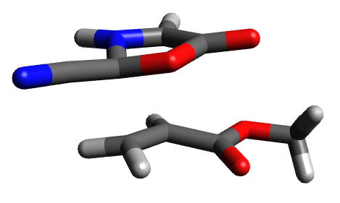
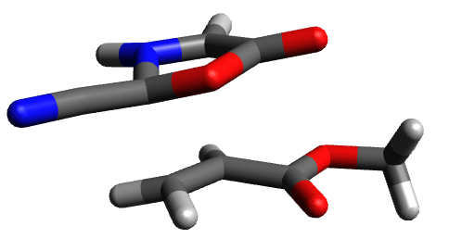
cyclic: conformations
DFT Hessian
HF Hessian
SQM Hessian

Slide 26
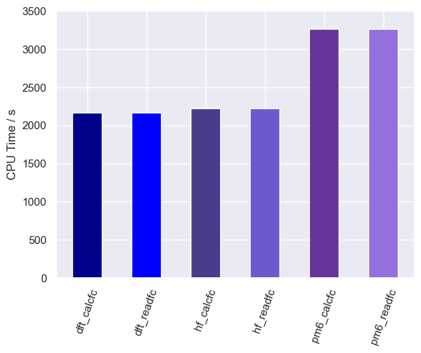
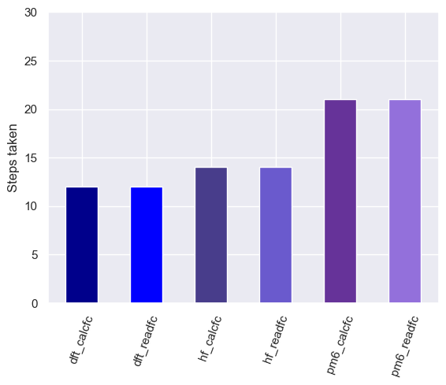
DA_1

Slide 27
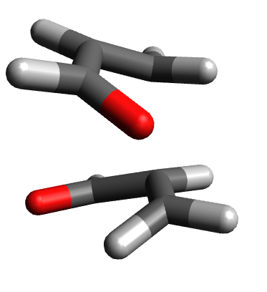
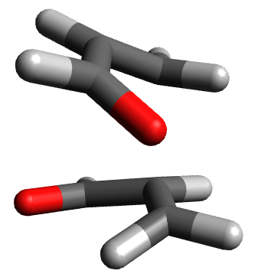
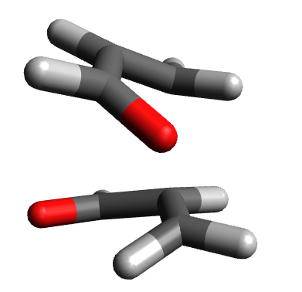
DA_1: conformations
DFT Hessian
HF Hessian
SQM Hessian

Slide 28
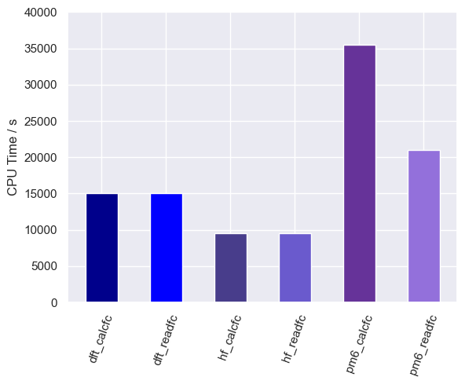
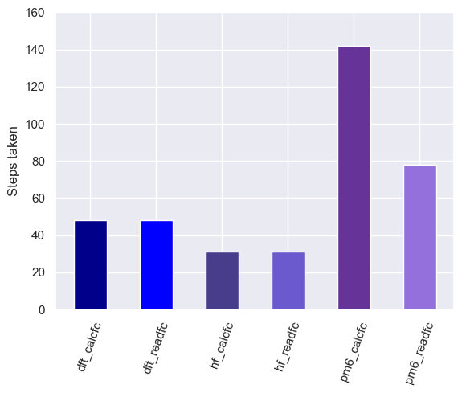
DA_2

Slide 29
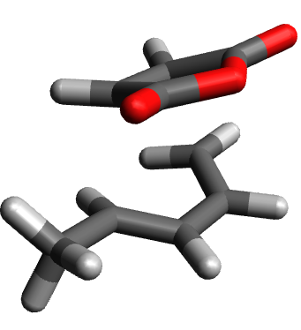



DA_2: conformations
DFT Hessian
HF Hessian
SQM_calcfc
SQM_readfc

Slide 30


IMDA_1

Slide 31




IMDA_1: conformations
DFT Hessian
HF Hessian
SQM_calcfc
SQM_readfc

Slide 32


IMDA_2

Slide 33



IMDA_2: conformations
DFT Hessian
HF Hessian
SQM Hessian

Slide 34


AM_92

Slide 35





AM_92: conformations
DFT Hessian
HF calcfc
HF readfc
SQM calcfc
SQM readfc
Incorrect TS:
All: N---C reacting bond rotation at around 77 1/cm

Slide 36


DA_1

Slide 37





DA_1: conformations
DFT calcfc
DFT readfc
HF calcfc
HF readfc
SQM Hessian
Incorrect TS:
All: Symmetric rocking at around 20-30 1/cm

Slide 38


DA_2
*
*

Slide 39





DA_2: conformations
DFT calcfc
DFT readfc
HF calcfc
HF readfc
SQM readfc
(SQM calcfc did not converge)
Incorrect TS:
DFT_calcfc, DFT_readfc and SQM_readfc: Anti-Houk to Houk RHC-Me rotation at around 180 /1cm
HF_calcfc, HF_readfc: Diene rocking at around 25-85 1/cm

Slide 40


IMDA_1

Slide 41






IMDA_1: conformations
DFT calcfc
DFT readfc
HF calcfc
HF readfc
SQM calcfc
SQM readfc
Incorrect TS:
R(O)C-CH2(R) bond rotation at around 28 1/cm

Slide 42


IMDA_2

Slide 43




IMDA_2: conformations
DFT Hessian
HF Hessian
SQM calcfc
SQM readfc
Incorrect TS:
Br(O)C-CH2(R) bond rotation at around 10 1/cm

Slide 44


cyclic
*
*

Slide 45





cyclic: conformations
DFT readfc
HF calcfc
HF readfc
SQM calcfc
SQM readfc
(DFT calcfc did not converge)
Incorrect TS:
DFT_readfc and SQM_readfc: (R)2NH--O=C(OMe)R H-bond rotation at around 10 1/cm
HF_calcfc: dipole rocking at around 42 1/cm
HF_readfc: not a TS (second order saddle point)
SQM_calcfc: R(O)C-OMe bond rotation at around 116 1/cm

Slide 46


allylic

Slide 47






allylic: conformations
DFT calcfc
DFT readfc
HF calcfc
HF readfc
SQM calcfc
SQM readfc
Incorrect TS:
All: (CH2)-N(CH3)R bond rotation at around 360 1/cm

Slide 48
Conclusions
DFT_calcfc and DFT_readfc are usually equally fast (almost none required reoptimisation)
HF_calcfc and HF_readfc are usually equally fast (almost none required reoptimisation)
SQM_calcfc is usually similar to SQM_readfc, or slighltly slower
HF initial Hessians were generally the fastest methods, (closely) followed by DFT Hessians and then SQM (PM6) Hessians. This could be because the HF Hessian balances accuracy with calculation speed better than the SQM Hessian, and therefore fewer optimisation steps are needed with a HF Hessian compared to an SQM Hessian
Computational speedup is not very large compared to the traditional DFT_calcfc method (HF_calcfc is approximately 80% the CPU time of DFT_calcfc, on average)

Slide 49

Alternative project: Human-guided TS conformation ranking by eigenvector analysis
Lam, Y. H., Grayson, M. N., Holland, M. C., Simon, A., & Houk, K. N. (2016). Theory and modeling of asymmetric catalytic reactions. Accounts of Chemical Research, 49(4), 750-762.
(2.5) Conformational ranking/filtering
(Density Functional Frequency Calculations)
- Compute Frequencies with freq keyword (Hessian eigenvalues and eigenvectors)
- Human selects internal coordinates they expect to contribute most to the final TS eigenvector (e.g. C—N bond in Aza-Michael)
- Automatically rank TS conformations by contribution of this internal coordinate to the eigenvector whose eigenvalue is the most negative (this is the eigenvector used in the eigenvector-following algorithm)
- These Hessians can then be used at the start of TS searching (they are required in any case – therefore the only computational cost is in the eigenvector calculations)

